Slide 1
Detecting Fake News using NLP and BERT
Submitted By
121CS0178 – RAHUL KINDO
121CS0217 – MD NAFIS AL SAFAYET
121CS0179 – NEELAMSETTI HARIKRISHNA
Submitted to:
Prof. RATNAKAR DASH

Slide 2
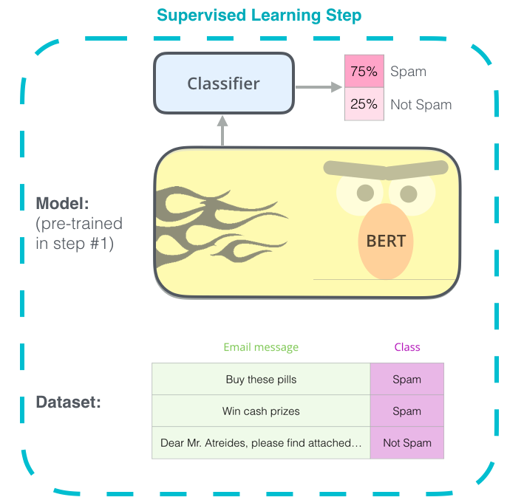
What is BERT?
1
Transformer-based Model
2
Bidirectional Learning
BERT, or Bidirectional Encoder Representations from Transformers, is a powerful language model based on the Transformer architecture.
BERT is trained on large text corpora to understand the contextual relationships between words, enabling bidirectional processing of input text.
3
Versatile Applications
BERT's pre-trained model can be fine-tuned for a variety of natural language processing tasks, including text classification, question answering, and, as we'll explore, fake news detection.

Slide 3
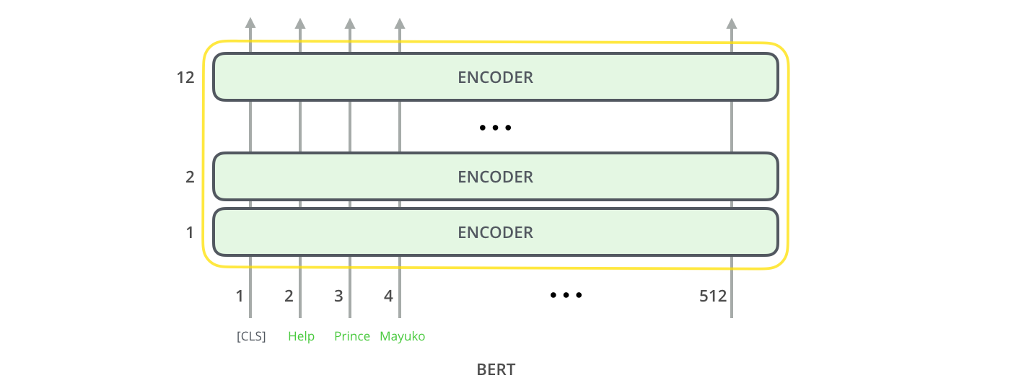
BERT’s (base) Architecture
1
Input Embedding
BERT takes text input and converts it into a numerical representation that the model can understand.
2
Transformer Layers
The core of BERT's architecture is a stack of Transformer layers, which use attention mechanisms to capture contextual relationships. In BERT base model, there are 12 encoded layers for preprocessing the data.
3
Output Prediction
BERT's final layer produces output predictions based on the learned representations, which can be used for various NLP tasks and the output is 768 featured vector.

Slide 4
BERT's Advantages for Fake News Detection
Contextual Understanding
Transfer Learning
Scalability
BERT's ability to understand the context of words and phrases is crucial for identifying subtle linguistic cues in fake news.
BERT's pre-trained model can be fine-tuned for the specific task of fake news detection, leveraging its general language understanding capabilities.
BERT's deep learning architecture allows it to handle large volumes of text data effectively, making it suitable for real-world fake news detection.

Slide 5
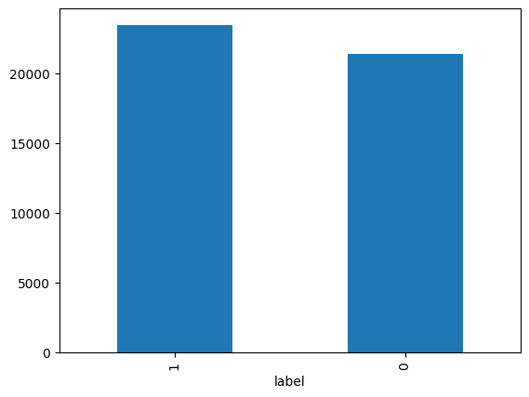
Data Preparation for Fake News Detection
Data Collection
Text Preprocessing
Collected a fake news dataset from the Kaggle dataset around 24000 samples of true and fake labels.
Clean and preprocess the text data, including tokenization, removal of stop words, and stemming or lemmatization.
Feature Engineering
Train-Test Split
Used the BERT preprocessed layer for extracting the features from the raw text of the dataset.
Divide the dataset into training and testing sets with testing size of 20% and training data size of 80% to evaluate the model's generalization capabilities.

Slide 6
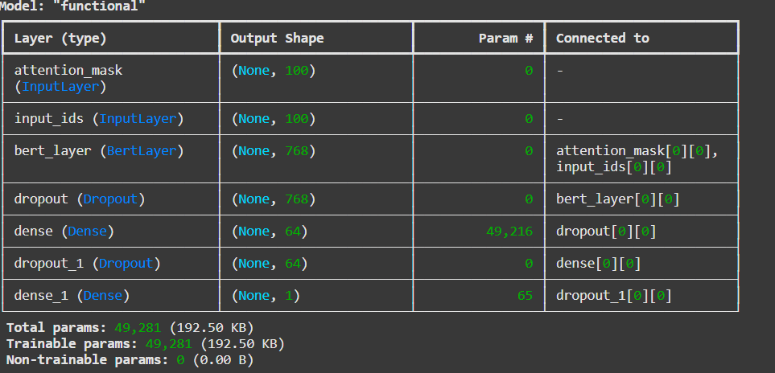




BERT-based Fake News Detection Model
Input Text
The model takes news articles as input, which can be real or fake.
BERT Encoder
The BERT model encodes the input text, capturing contextual relationships and generating meaningful representations.
Classification Head
A neural network layer of 64 neurons is added to the bottom of the bert layer for performing the sentiment analysis.
Output Prediction
The model outputs a binary classification, identifying the input as either real or fake news.

Slide 7
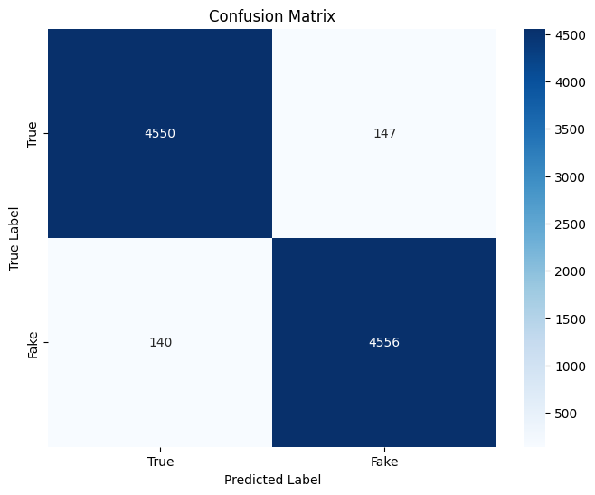


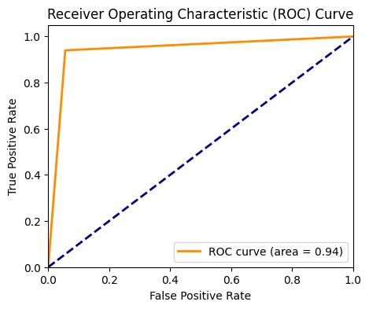


Evaluating the Model's Performance
Accuracy
Precision
Measures the overall correctness of the model's predictions.
Reflects the model's ability to correctly identify real news articles.
Recall
ROC-AUC
Measures the model's capacity to identify all fake news articles.
Evaluates the model's overall classification performance through the area under the receiver operating characteristic (ROC) curve. The area of the curve indicates the accuracy of the model.

Slide 8
Conclusion
By leveraging the powerful language understanding capabilities of BERT, organizations and individuals can develop effective fake news detection models. This approach can help combat the spread of misinformation and promote the dissemination of accurate, reliable information in the digital age.

Slide 9


